Slide 1
MAJOR DISEASES OF SUGARCANE AND THEIR INTEGRATED MANAGEMENT
Dr. Deeksha Joshi
Senior Scientist
Division of Crop Protection

Slide 2
Sugarcane is an important cash crop of India.
Grown in about 5.02 million hectare with an average yield of about 69.0 t/ha.
The crop is vulnerable to number of diseases.
Sugarcane diseases can be classified in two categories i.e. seed piece transmissible diseases, and non-seed piece transmissible diseases.

Slide 3
Major Diseases
Red rot
Smut
Wilt
Leaf Scald
Grassy Shoot (GSD)
Ratoon stunting (RSD)
Mosaic

Slide 4
Leaf spot diseases
Brown spot
Eye spot
Yellow spot
Pineapple disease
Rust
Pythium root rot

Slide 5
Fungal Diseases and their causal organisms
Red rot
Colletotrichum falcatum
Smut
Sporisorium scitamineum
Cephalosporium sacchari
Wilt
Fusarium moniliforme
Fusarium subglutinans
Fusarium sett and stem rot
Gibberella fujikuroi
Pineapple disease
Ceratocystis paradoxa
Yellow spot
Mycovellosiella koepkei
Ring spot
Leptosphaeria sacchari
Rust
Puccinia melanocephala

Slide 6
Bacterial Diseases
Leaf Scald
Xanthomonas albilinians
Ratoon Stunting
Leifsonia xyli sub sp. xyli
Red stripe
Pseudomonas rubrilineans
Viral diseases
Sugarcane mosaic virus disease (SMD)
Sugarcane yellow leaf disease (YLD)
Phytoplasmal disease
Grassy shoot disease (GSD)

Slide 7
Losses from sugarcane diseases
Growers
Reduction in no. of millable canes
Reduction in cane yield
Poor quality seed
Poor ratoon stand
Millers
Poor juice extractability
More reducing sugars
Reduction in sugar recovery

Slide 8
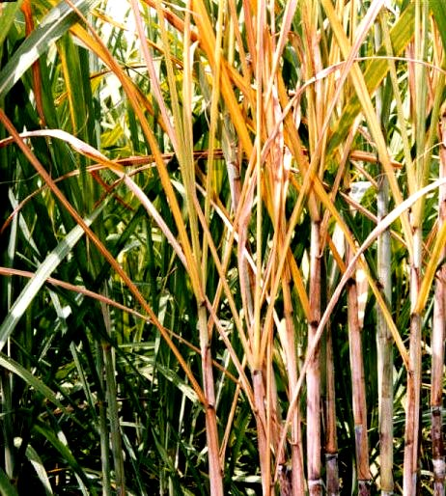
Red rot Disease
Symptoms
The characteristic symptoms appears as the grand growth phase accompanied with sufficient stalk formation. This starts with the yellowing of one or two leaves of a crown (3rd or 4th leaf). The yellowing as well as withering of leaves starts from margin. Later on the entire crown becomes light orange yellow and dries.

Slide 9
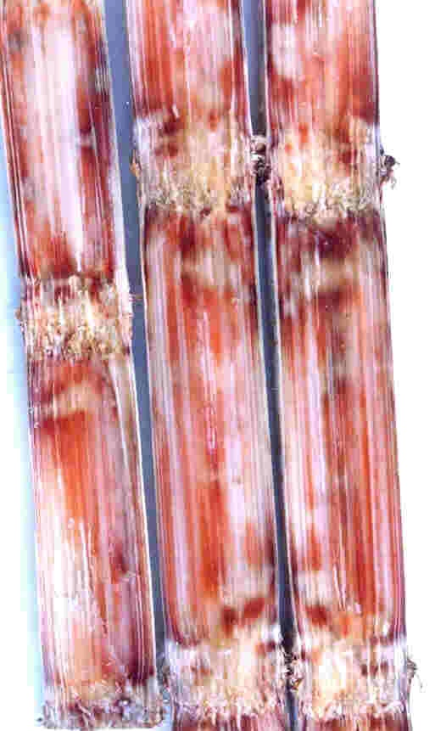
Contd…
Affected stalks exhibit purplish discoloration of rind. On splitting the canes length-wise, the internal tissues display red discoloration interrupted by white patches. The tissue emits smell of vinegar.
The other most important phase of the disease is the infection on leaf midrib and leaf lamina.

Slide 10
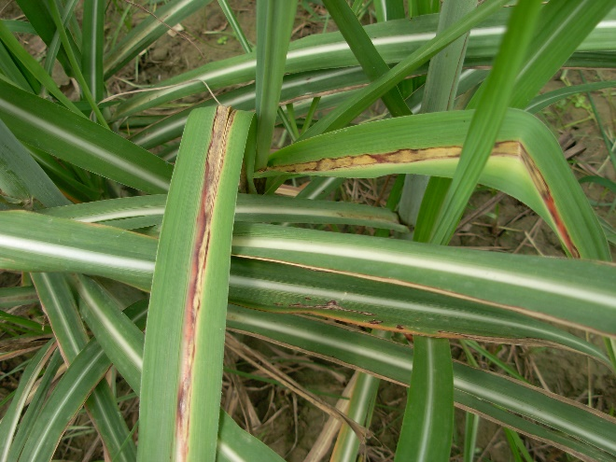
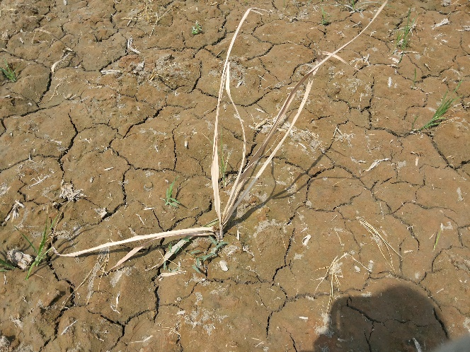
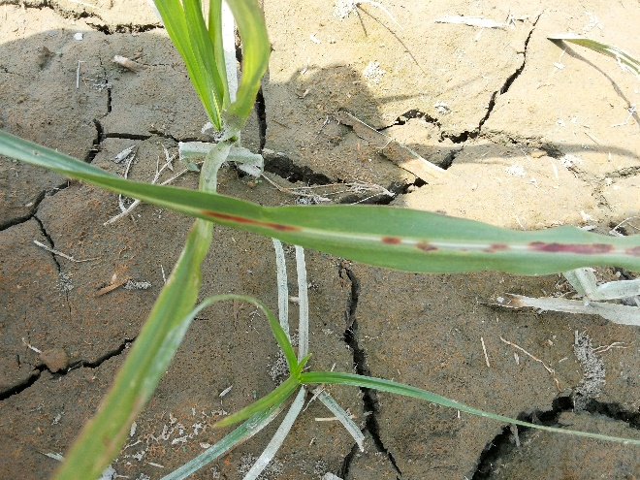
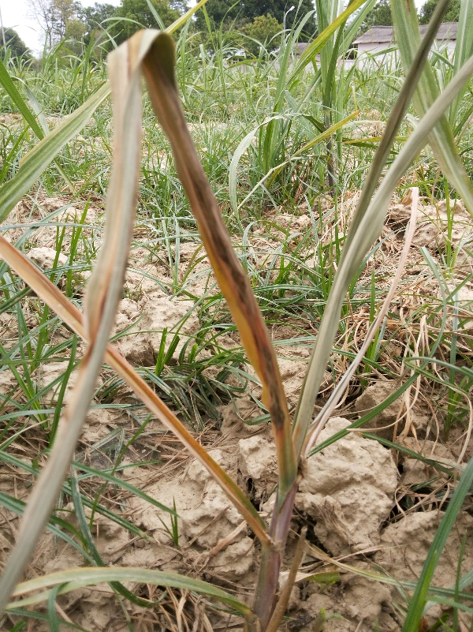

Slide 11
Crop damage due to red rot
Resistant
Diseased

Slide 12
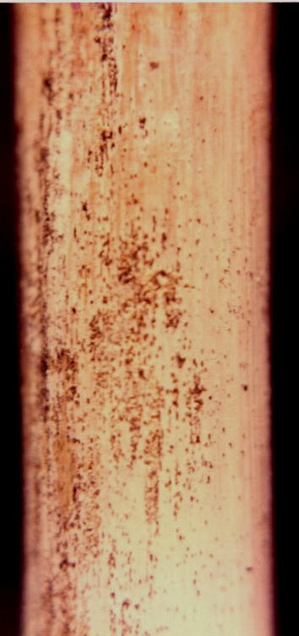
Discolouration of rind

Slide 13
SMUT
Symptoms
Affected plants have slender and thin stalks.
The leaves are stiff with acute angle.
Emergence of a black whip like structure from central core of meristematic tissue.
Whip when young is covered by a thin, white papery membrane.
On maturity it ruptures and millions of tiny black teliospores liberated and disseminated by wind.

Slide 15
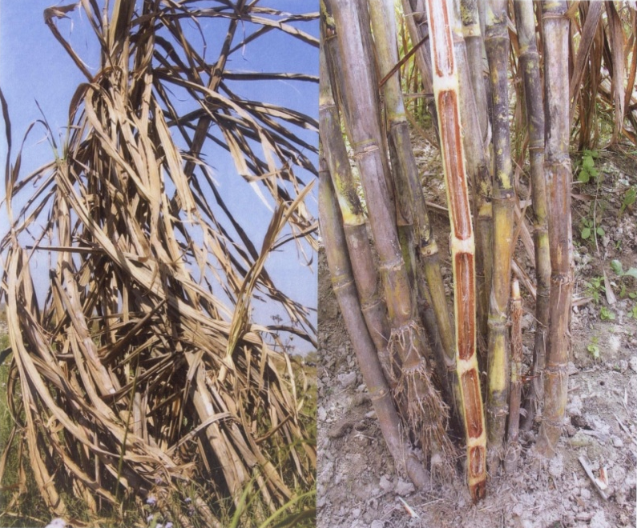
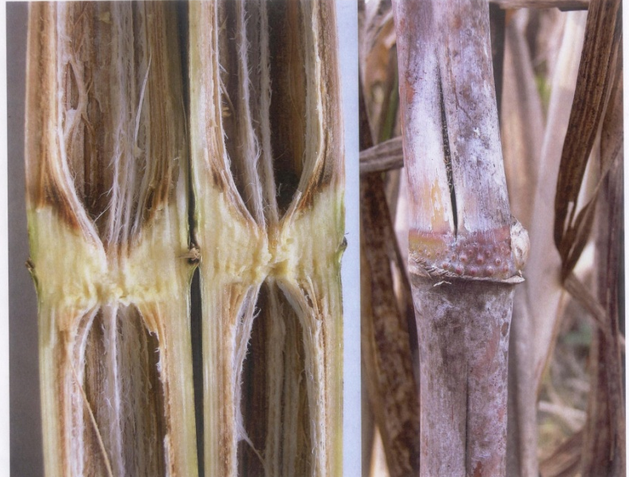
WILT
Symptoms
Appears mainly during monsoon and post-monsoon period.
The leaves show yellowing followed by drying from upward.
Late in season, crown withers and plant may die.
The split open cane manifests dull red colour of internodes and due to drying of tissues the internode becomes hollow.
Pith becomes fibrous.

Slide 16
Pokkah boeng Disease
The general symptoms of pokkah boeng are mainly of three types:
Chlorotic phase
Acute phase or top rot phase
Knife-cut phase (associated with top rot phase)

Slide 17
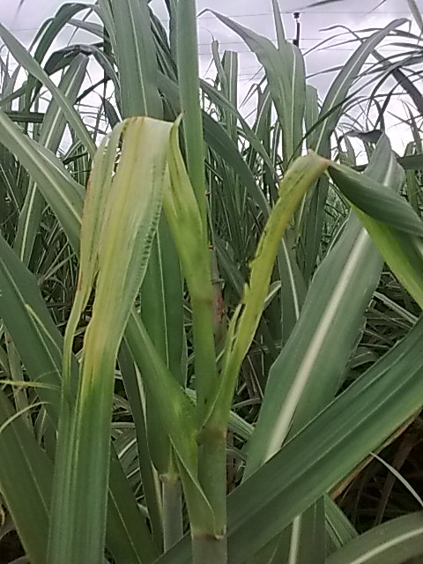
Pokkah boeng Disease
Chlorotic phase
The earlier symptom of pokkah boeng is a chlorotic condition towards the base of the young leaf and occasionally on the other parts of the leaf blades.
Frequently, a pronounced wrinkling, twisting and shortening of the leaves accompanied the malformation or distortion of the young leaves. The base of the affected leaves is seen often narrower than that of normal leaves.

Slide 19
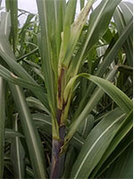
In affected mature leaves, the irregular reddish stripes and specks are observed within a chlorotic part. The reddish area sometimes develops into the lesions of a rhomboid shape which turn dark reddish to brown colour, producing a burned appearance. Leaf sheaths also observed with chlorotic conditions in some cases. Later, irregular necrotic areas of reddish colour, similar on the leaf blades are also noticed on leaf sheath and midribs.

Slide 20
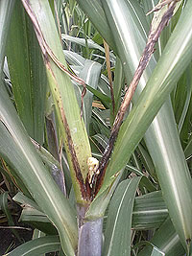
Acute or top rot phase
This is the most advanced and serious stage of pokkah boeng.
The young spindles are killed and the entire top dies. Leaf infection sometimes continued to downward and penetrates in the stalk by way of a growing point.
In advance stages of infection, the entire base of the spindle and even growing point show a malformation of leaves, pronounced wrinkling, twisting and rotting of spindle leaves followed by top rot of the tender tissues of the apical part of the cane.

Slide 21
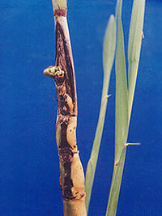
knife-cut phase
The symptoms are characterized by one or two or even more transverse cuts in the rind of the stalk/stem in such a uniform manner as if, the tissues are removed with a sharp knife.
On stripping off the leaves, large horizontal conspicuous cuts are visible on stalks.

Slide 22
Sett Rot (Ceratocystis paradoxa)
It is an important soil borne disease which affects sett germination. The disease is also called as “Pineapple disease” because the split open canes emit an odour reminiscent of pineapple fruits.

Slide 23
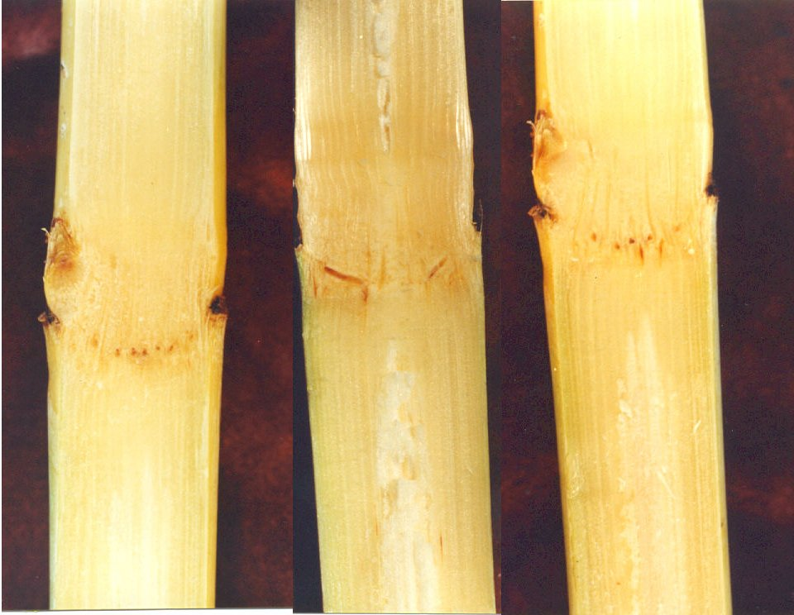
RATOON STUNTING DISEASE (RSD)
Symptoms
Affected plants are usually stunted and have poor root system.
Show reduced tillering and shortening of internodes.
The diseased shoots on splitting show orange-red discolouration of fibro-vascular bundles at the maturity.

Slide 24
RSD bacterial cells

Slide 25
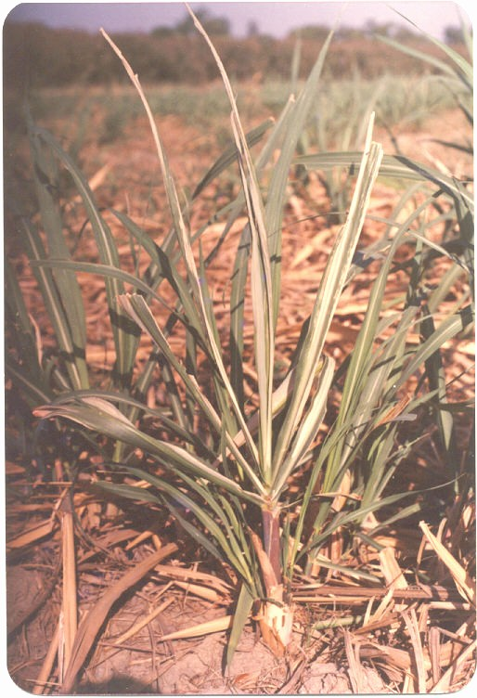
LEAF SCALD
Symptoms
The disease, in nature, occurs in two distinct phases.
Acute phase
Affected clumps suddenly show wilt symptoms and die without displaying any of the diagnostic symptoms.
Chronic phase
Appears in plants growing under stress conditions, like drought, low temperature, poor soil fertility or in waterlogged condition.

Slide 26
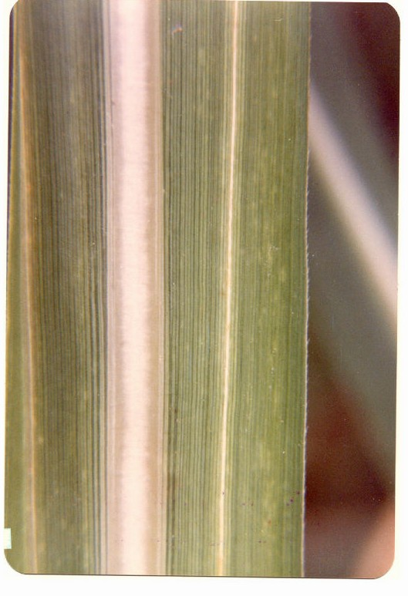
Affected plants display characteristic whitish lines which usually run the full length of the leaf blade and the leaf sheath.
The lines in some leaves broaden and diffuse, resulting in the death of the leaves which ultimately wither away.
The drying is always from tip downwards; this gives a scalded appearance to the clump.

Slide 27
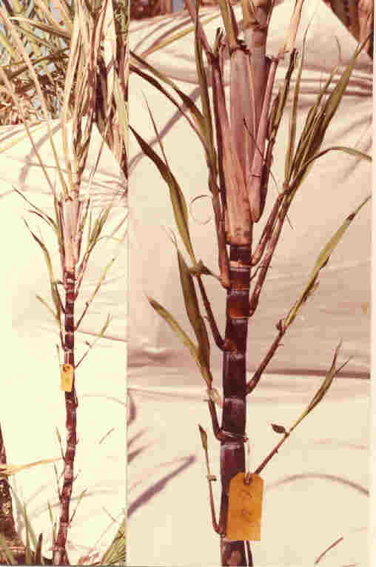
Some time, the affected canes show sprouting of lateral buds.
Acro-petal bud sprouting

Slide 28
GRASSY SHOOT DISEASE (GSD)
Symptoms
GSD is characterized by the production of numerous lanky tillers with abnormal morphology.
Premature excessive tillering gives a grass like appearance to the clump.
Diseased plant exhibits varying degrees of loss of chlorophyll ranging from green to white.

Slide 29
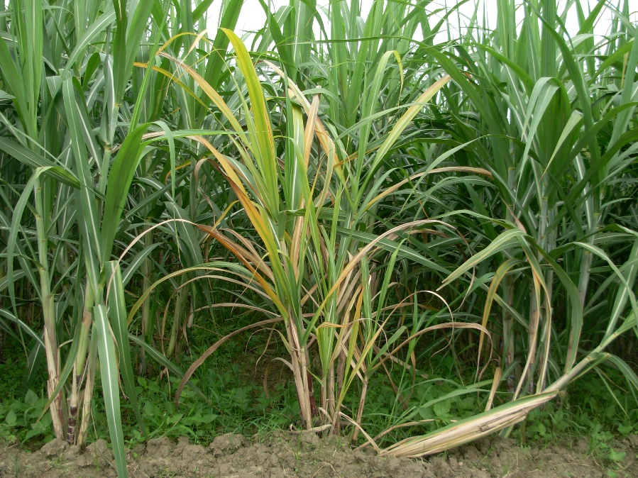
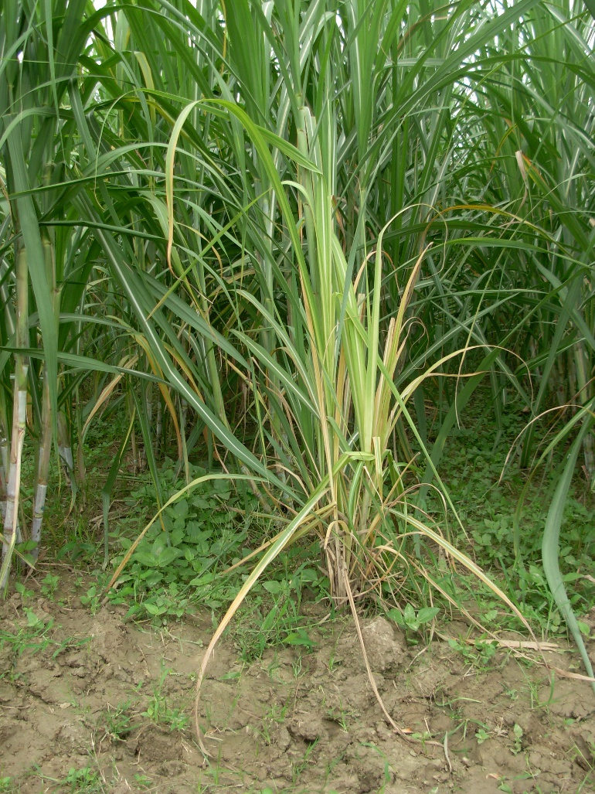
Deltocephalus vulgaris insect vector of GSD

Slide 30
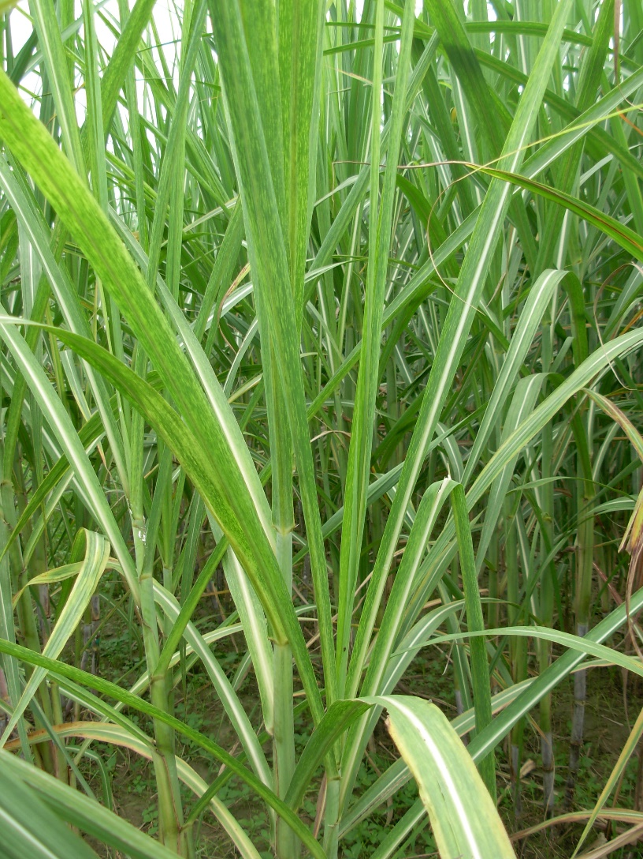
MOSAIC
Symptoms
Mottling of the leaf displays light-green and yellowish patches contrasting with the normal dark-green healthy tissues.
Prominent symptoms appear on the basal portion of younger leaves.
In severe cases, the cane becomes stunted.

Slide 31
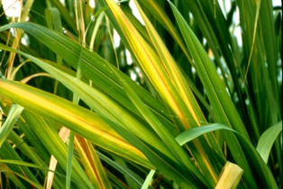
Sugarcane Yellow Leaf Disease (YLD)
Symptoms are yellowing of the leaf midrib on the underside of the leaf.
Yellowing appears on leaves 3 to 6 counting down from the top expanding the spindle leaf.
Yellowing is most prevalent and noticeable in mature cane from October until end of harvest in March.

Slide 32
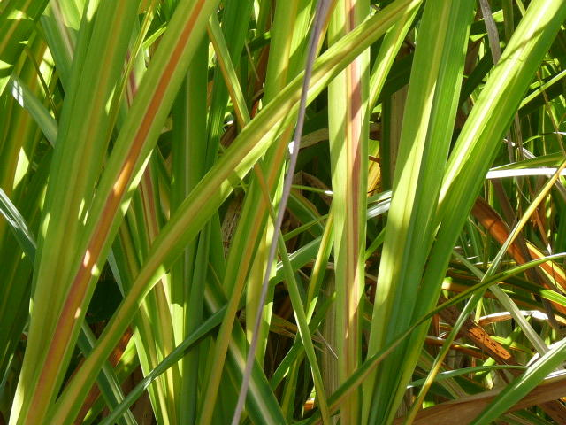
Contd…
Yellowing expands out from the leaf mid rib in to the leaf blade as the season progresses until general yellowing of the leaves can be observed from the distance eventually all most all the leaves of the plant turn yellow.

Slide 33
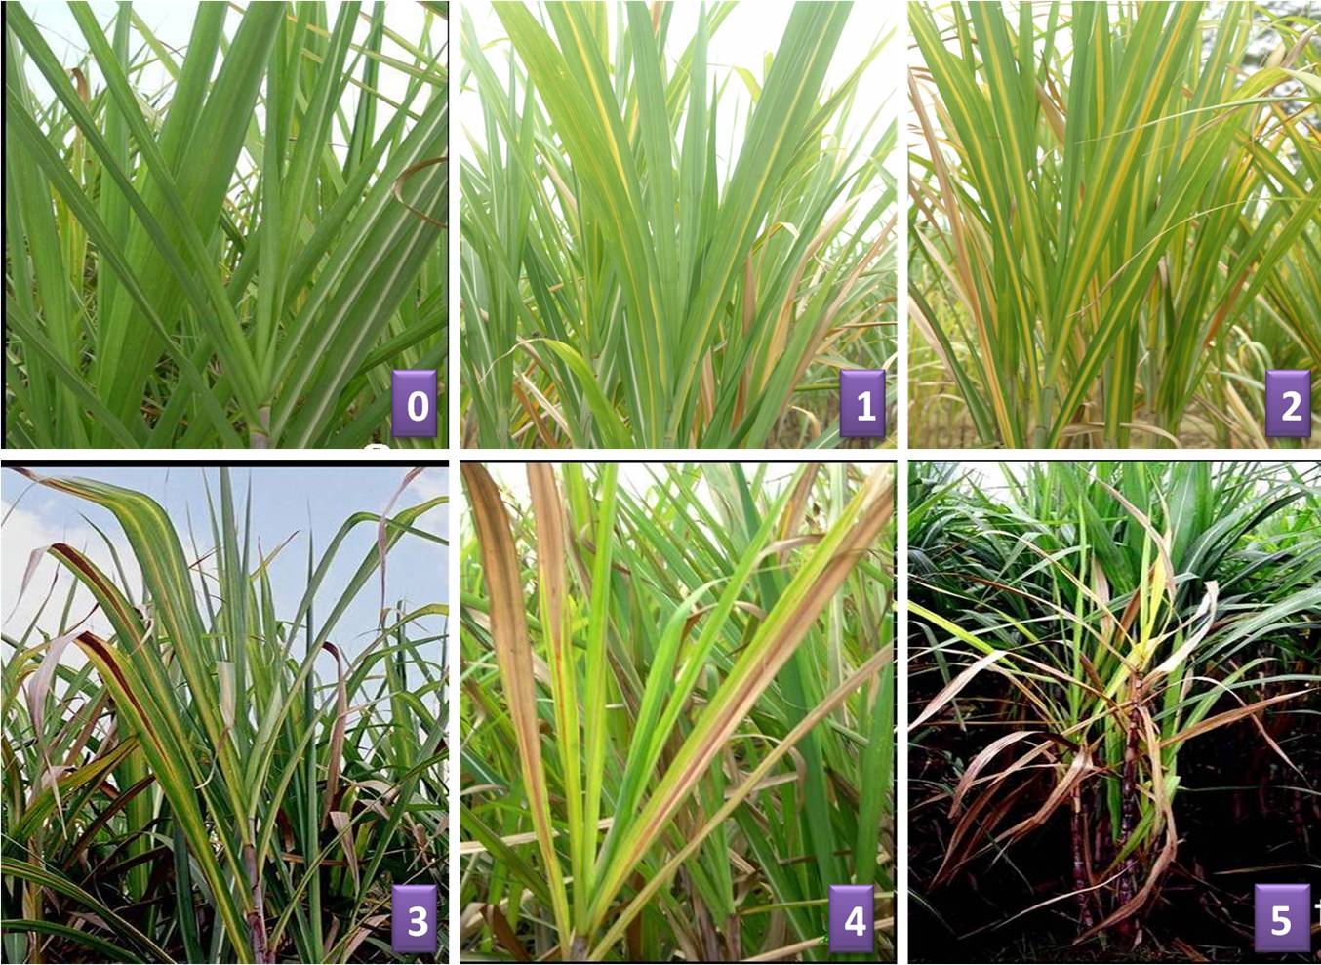

Slide 34
Integrated disease management (IDM)

Slide 35
Integrated disease management (IDM)
Roguing
Stubble shaving
Discontinuation of ratooning of diseased crop
Biological control

Slide 36
jksx dk izcU/ku

Slide 39
Trichoderma multiplied on organic substrates like sorghum grins/ sand-maize-meal medium.
Colonized Sand maize/sorghum grains nucleus culture of Trichoderma is mixed @ 2 kg in 20 kg of fresh sterilized FYM/ Press mud, filled in polythene bags (500g/bag) and incubated for 15 days at room temperature.
20 kg of colonized FYM is then mixed with 200 kg of unsterilized FYM/ press mud and applied @ 2 kg/100 m row as soil application at the time of planting.
The above quantity of TMC can also be applied around the clumps at tillering stage both in plant and ratoon crop.

Slide 40
Mass multiplication of richoderma for field application….
For commercial culture production of Trichoderma, a 2’’ layer of fresh unsterilized Press is filled in a 2.0x1.5x0.5 meter size pit and 2kg culture of Trichoderma as prepared above on Sand Maize Medium/Sand Oat medium is spread over it and again 2’’ layer of press mud is added over it followed by further spreading of 2kg of foundation culture of Trichoderma over it. This process is repeated till the pit is completely filled.
Contd…

Slide 41
Mass multiplication …………….
The pit is then covered with sugarcane trash/polythene sheet and watered periodically to maintain sufficient moisture. The press mud is turned frequently for better growth and to provide aeration. The commercial culture of Trichoderma will be now ready after about 15 days for field application.

Slide 42
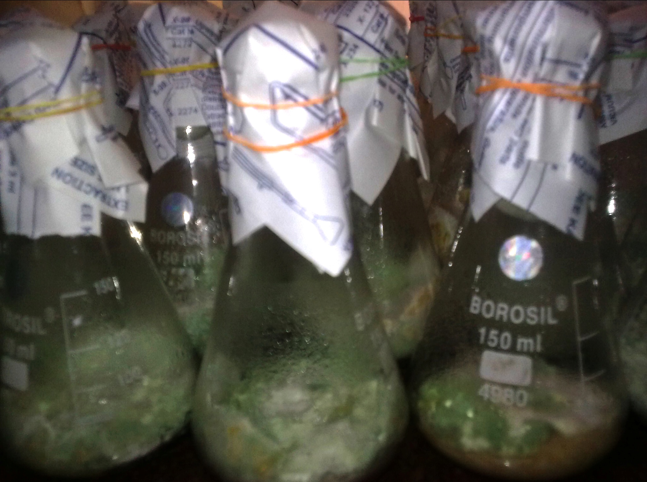

Slide 43
Pressmud colonized by T. harzianum

Slide 44
Suitable time for mass multiplication of commercial culture of Trichoderma
The commercial culture as described above must be prepared at least 15 days before sugarcane planting preferable between 15 January to 15 March as during this period the temperature remains favorable for the growth of Trichoderma.

Slide 45
Precautions to be taken for proper growth of Trichoderma
Proper moisture of press mud i.e. about 30% should be maintained during the preparation of commercial cuture. It should not form hard lump while preparing ladoo.
The temperature should not exceed above 30ºC during the preparation of commercial culture.

Slide 46
Quality parameters for Bio-agent Formulations
Formulation should be stable at 30⁰C temperature and 65 % RH
Spore count/ CFU = 2 X 10⁶ spores/ gm or ml
Other microbial contaminants (Shigella, Salmonella, Vibrio) < 1 x 10⁴ spores/ g or ml
Moisture content < 8 % for fungal bio-agents and < 12% for bacterial bio-agents

